Slide 1

Ryan G Nattrass PhD
Data Analyst

Slide 2

Has the world recovered from COVID-19 in 2025
5
This Analyses seeks to answer the questions of:
Did all countries respond the same way to the pandemic and if they differed, how? Why?
IF forecasted, does demographic data line up with current data, indicating that the pandemic has been recovered from?
Which countries fared the worst and should be most prepared for the future similar scenario?
Dataset: “United Nations, Department of Economic and Social Affairs, PopulationDivision(2024). World Population Prospects 2024, Online Edition.“
(https://population.un.org/wpp/downloads?folder=Standard%20Projections&group=CSV%20format )

Slide 3
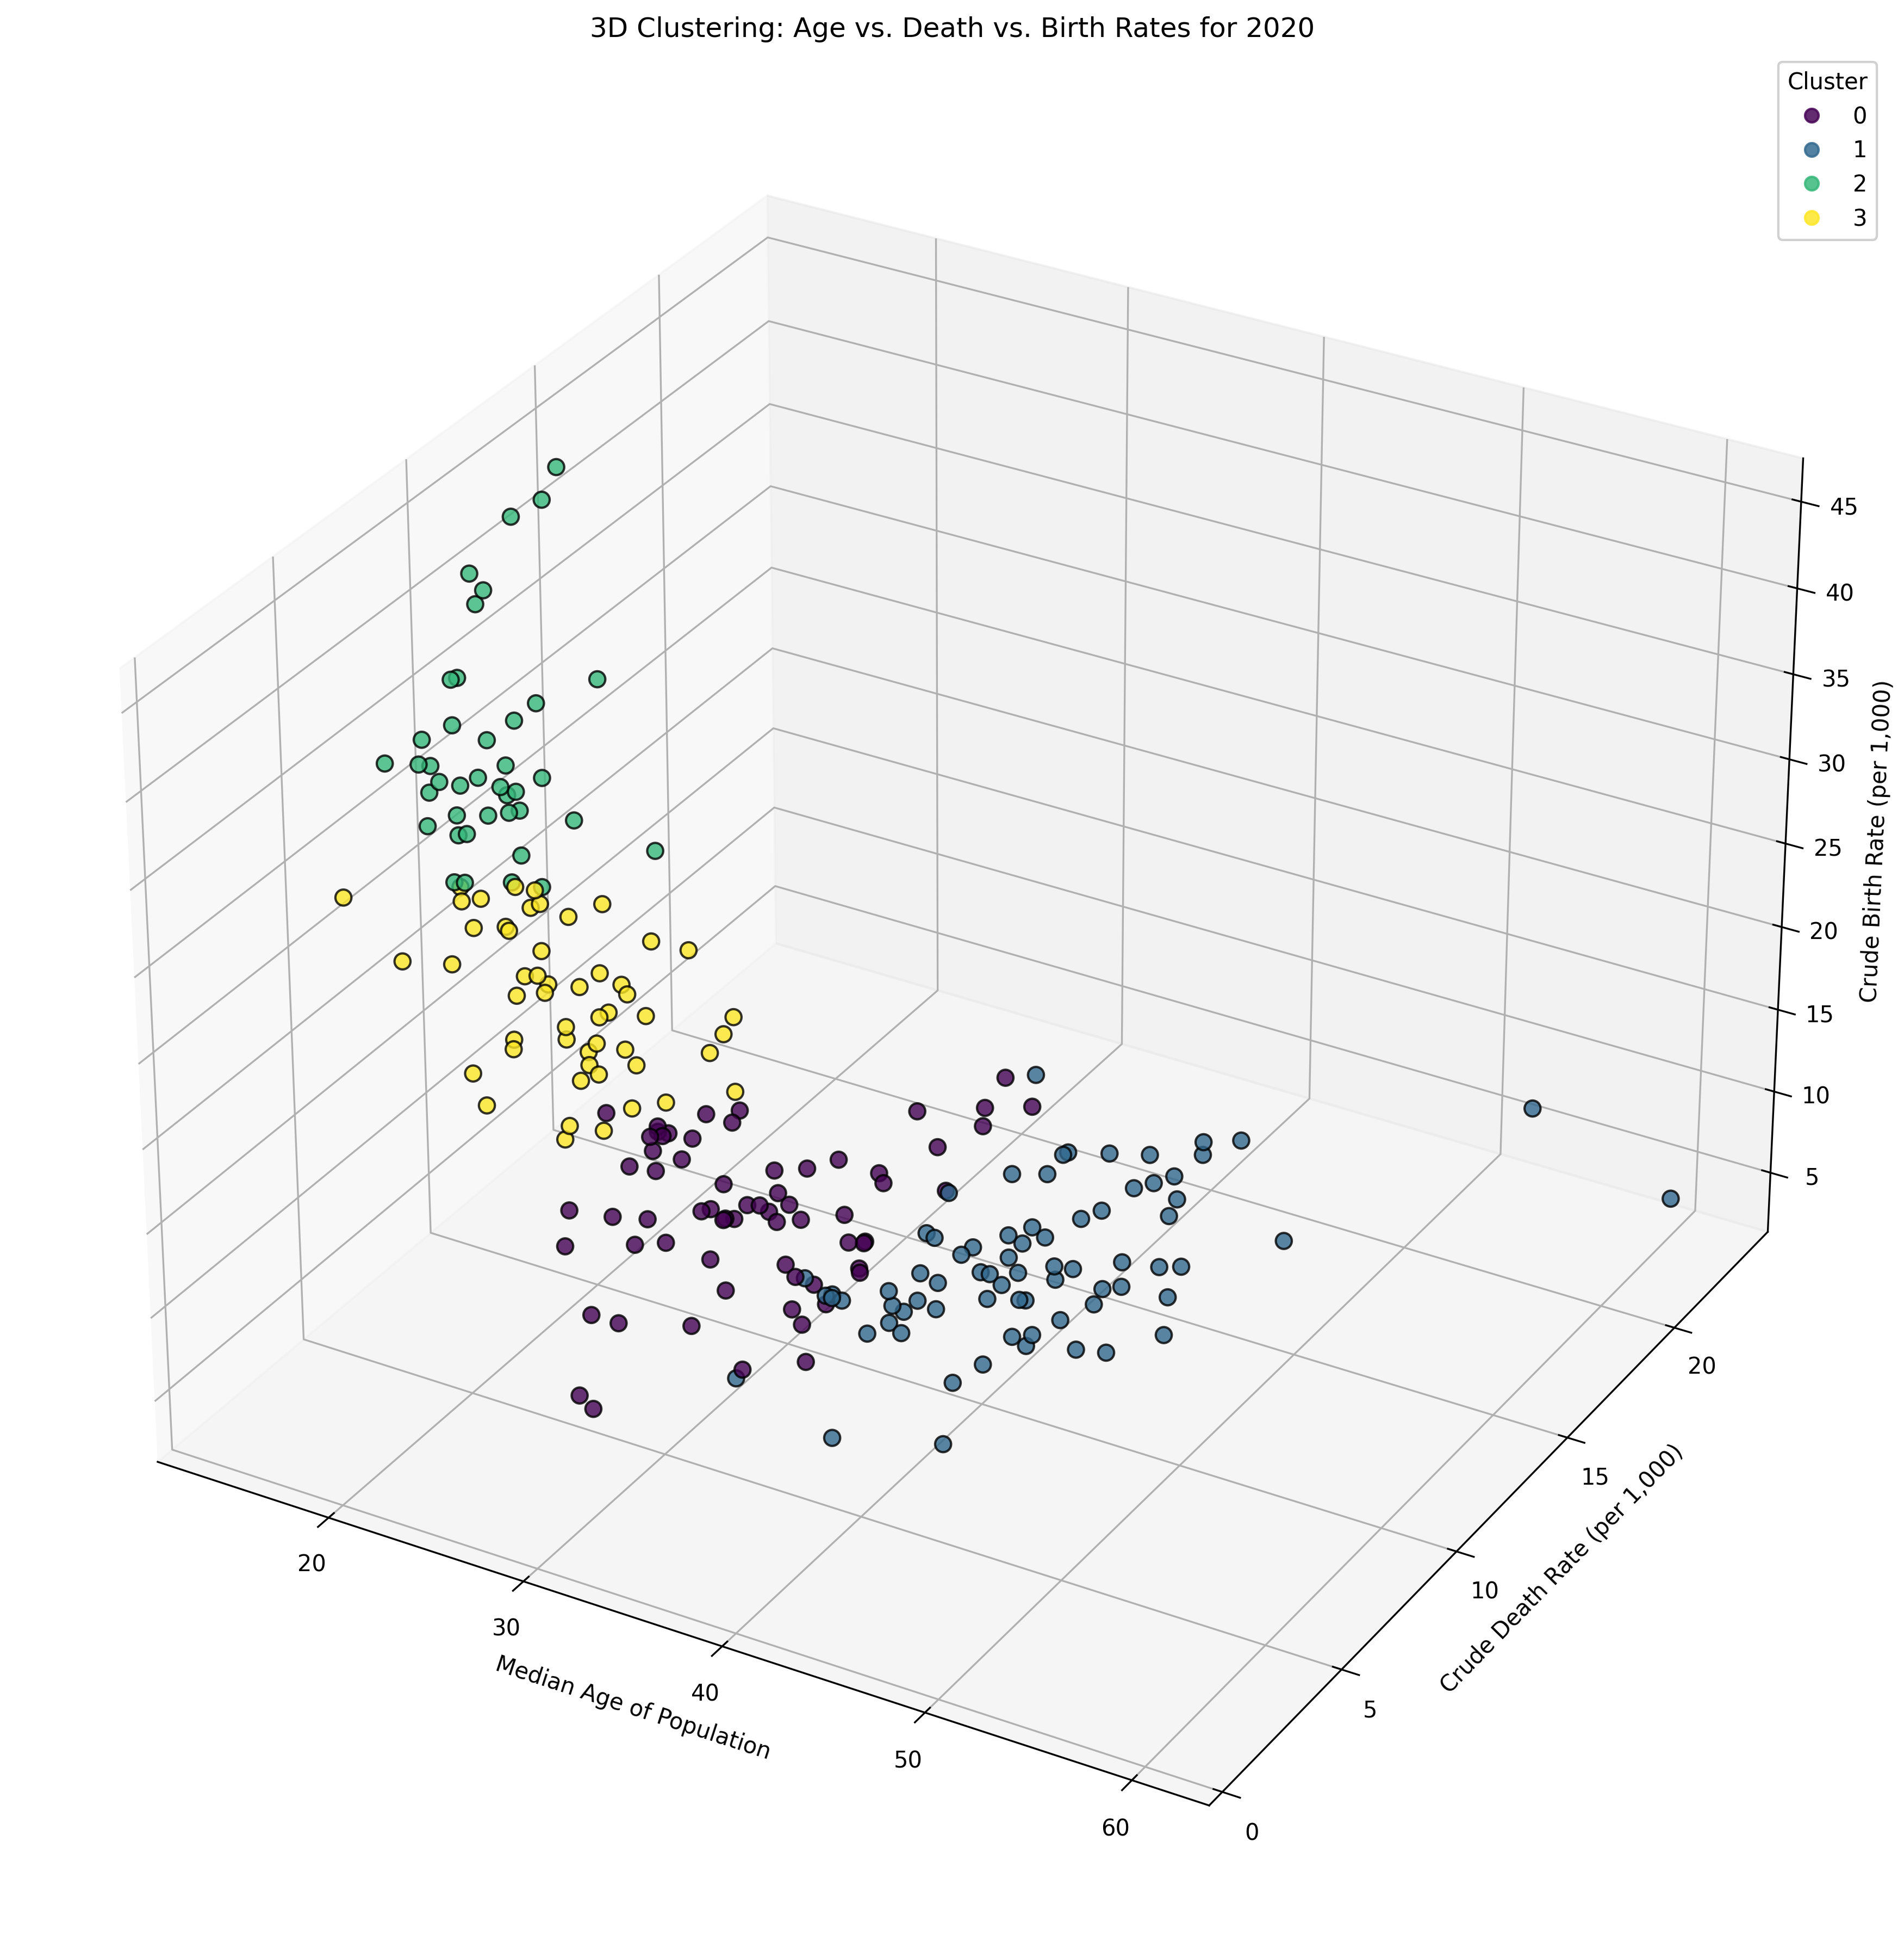
COVID-19 Analyses Finding Interesting Demographics
5
Python-tools enables quick analysis of multiple variables
Most influential variables enable Clustering segmentation of countries for easier in-depth analysis
https://github.com/CarbonSnitch/RGN_UN_COVID_19_2025?tab=readme-ov-file

Slide 4
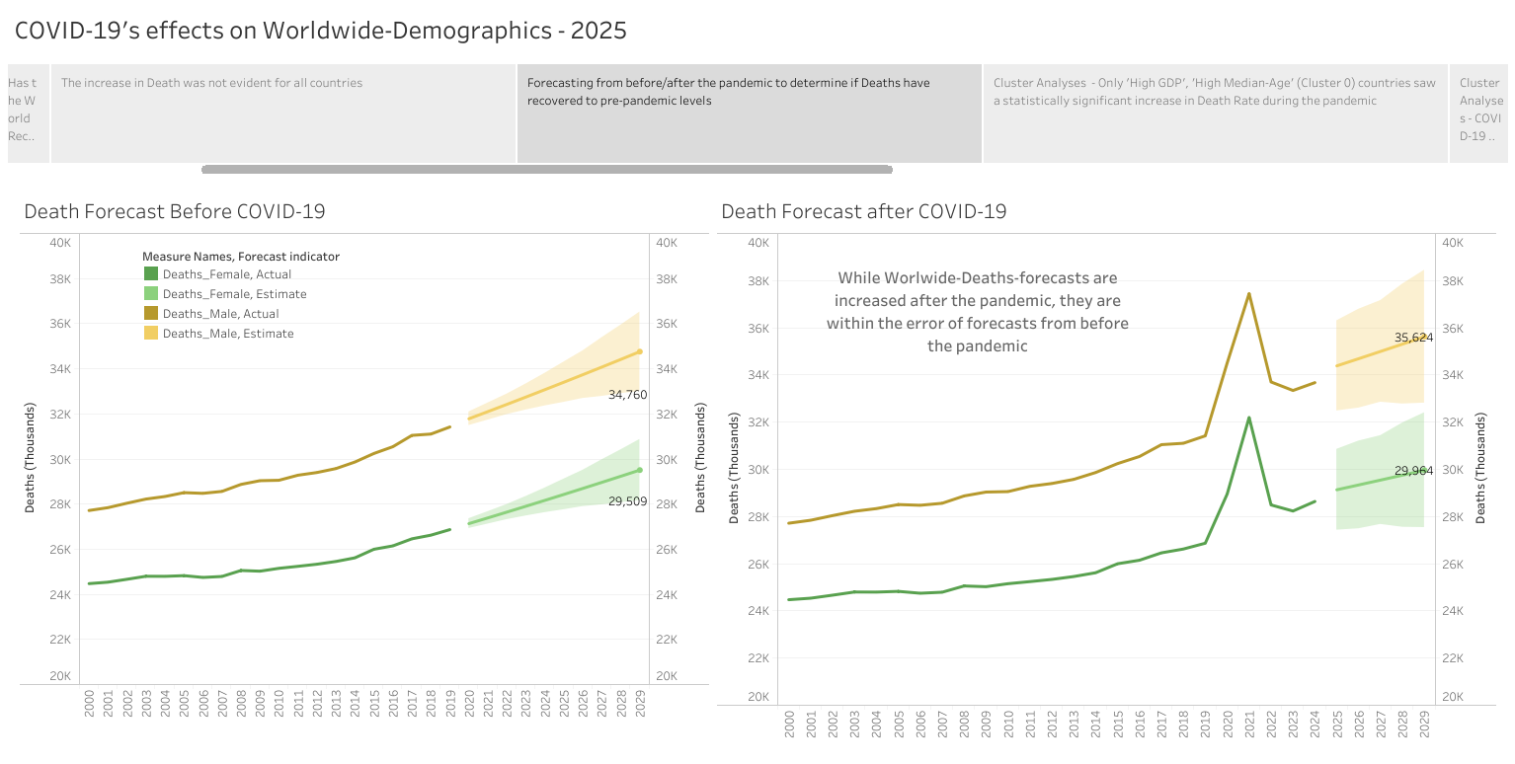
Death-rate has returned to normal in 2025
5
https://public.tableau.com/app/profile/ryan.nattrass/viz/Before_AfterCOVID_2015/COVID-19STORY?publish=yes

Slide 5
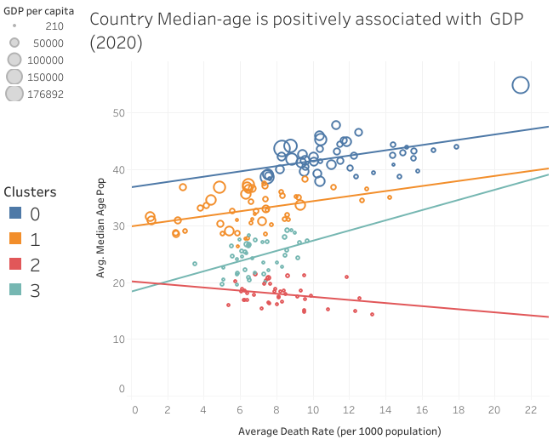
COVID-19 Analyses Clustering
5
Death-rate in cluster 0 in 2020 is statistically-significantly larger than the death-rate in cluster 2, the countries with the lowest GDP-per-capita
Clustering-analysis shows that the highest death-rate during COVID-19 pandemic is in High-GDP-per-capita, High-Median-Age Countries
https://public.tableau.com/app/profile/ryan.nattrass/viz/Before_AfterCOVID_2015/COVID-19STORY?publish=yes

Slide 6
COVID-19 Demographic analysis Data-driven recommendations
5
All countries did NOT fare equally during COVID-19 with the countries with the highest GDP-per-capita having a larger death-rate during COVID-pandemic than the lowest GDP-per-capita countries
It would appear that in 2025, the death-rate has returned to a level comparable to forecasts from pre-COVID. This would indicate that the world has indeed recovered effectively from COVID-19 in 2025.

